Slide 1

Class 10 Chemistry
Multiple Choice Questions
20 High-Yield MCQs covering Chemical Reactions, Acids, Bases & Salts, and Metals & Non-Metals with detailed explanations.

Slide 2


Chapter 1: Chemical Reactions & Equations
Questions 1 to 7 • Focus on Reaction Types, Balancing & Redox

Slide 3









Question 01 / 20
Which of the following processes represents a chemical change?
Sublimation of camphor crystals
Dissolution of salt in water
Digestion of food in our body
Melting of ice into water
Class 10 Science • Chemistry
Slide 3

Slide 4


Answer & Explanation • Q01
Digestion of food in our body
Detailed Explanation
A chemical change involves the formation of new chemical substances with completely different properties:
•
Digestion of food: Complex food molecules (e.g., carbohydrates, proteins) are broken down into simpler substances (like glucose, amino acids) using enzymes. This process is chemical and irreversible.
•
Sublimation, Dissolution, and Melting: These are all physical changes because no new chemical bonds are broken/formed and original substances can be recovered.
Class 10 Science • Chemistry
Slide 4

Slide 5


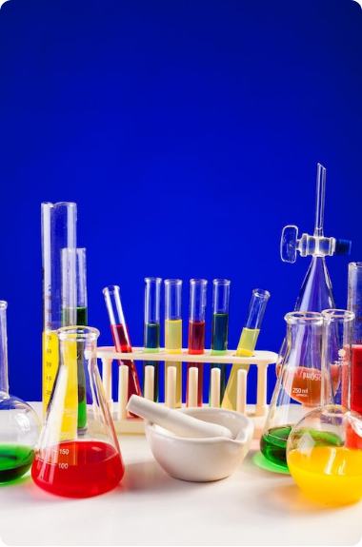





Question 02 / 20
When aqueous solutions of Potassium Iodide and Lead Nitrate are mixed, a yellow precipitate is formed. This is an example of a:
Combination reaction
Decomposition reaction
Double displacement reaction
Thermal decomposition reaction
Class 10 Science • Chemistry
Slide 5

Slide 6
Answer & Explanation • Q02
Double displacement reaction
Detailed Explanation
In a double displacement reaction, two compounds exchange their ions to form two new compounds.
•
The potassium ions (K⁺) and lead ions (Pb²⁺) swap partners.
•
Insoluble insoluble Lead Iodide (PbI₂) precipitates out as a bright yellow solid.
Class 10 Science • Chemistry
Slide 6

Slide 7


Question 03 / 20
Consider the reaction: CuO + H₂ → Cu + H₂O. Which substance is getting oxidised and which acts as the reducing agent?
CuO is oxidised, H₂ is reducing agent
H₂ is oxidised, H₂ is reducing agent
CuO is reduced, Cu is reducing agent
H₂ is reduced, CuO is reducing agent
Class 10 Science • Chemistry
Slide 7

Slide 8

Answer & Explanation • Q03
H₂ is oxidised, H₂ is reducing agent
Detailed Explanation
This is a classic Redox (Reduction-Oxidation) reaction:
•
Oxidation: Gain of oxygen. H₂ gains oxygen to become H₂O, so H₂ is oxidised.
•
Reducing Agent: The substance that causes reduction by taking away oxygen (or providing electrons). Here, H₂ is the reducing agent.
•
Conversely, CuO loses oxygen and is reduced, making CuO the oxidising agent.
Class 10 Science • Chemistry
Slide 8

Slide 9
Question 04 / 20
When calcium oxide (quick lime) reacts vigorously with water, slaked lime is produced along with heat. This reaction is classified as:
Endothermic & Combination
Exothermic & Decomposition
Exothermic & Combination
Endothermic & Displacement
Class 10 Science • Chemistry
Slide 9

Slide 10

Answer & Explanation • Q04
Exothermic & Combination
Detailed Explanation
•
Combination Reaction: Two reactants (CaO and H₂O) combine to give a single product, calcium hydroxide [Ca(OH)₂].
•
Exothermic Reaction: A large amount of heat energy is liberated during the process, making the container hot.
Class 10 Science • Chemistry
Slide 10

Slide 11
Question 05 / 20
Which of the following balanced equations correctly represents the reaction between nitrogen gas and hydrogen gas to form ammonia?
N₂ + H₂ → NH₃
N₂ + 3H₂ → 2NH₃
2N + 6H → 2NH₃
N₂ + 2H₂ → 2NH₃
Class 10 Science • Chemistry
Slide 11

Slide 12
Answer & Explanation • Q05
N₂ (g) + 3H₂ (g) → 2NH₃ (g)
Detailed Explanation
According to the Law of Conservation of Mass, the total number of atoms of each element must be equal on both sides:
•
Reactant side: 2 Nitrogen atoms (from N₂) and 6 Hydrogen atoms (from 3H₂).
•
Product side: 2 Nitrogen atoms and 6 Hydrogen atoms (from 2NH₃).
•
Nitrogen and Hydrogen exist as diatomic molecules (N₂ and H₂) in standard elemental state.
Class 10 Science • Chemistry
Slide 12

Slide 13


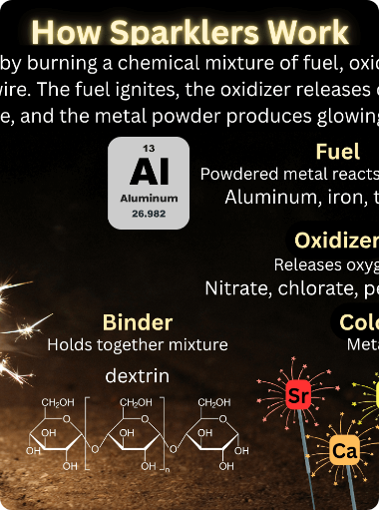


Question 06 / 20
Sublimation of dry ice (solid CO₂) is an example of an:
Exothermic chemical reaction
Endothermic physical process
Exothermic physical process
Endothermic chemical reaction
Class 10 Science • Chemistry
Slide 13

Slide 14
Answer & Explanation • Q06
Endothermic physical process
Detailed Explanation
Sublimation involves the phase transition directly from solid to gas without entering a liquid state:
•
Physical Process: The chemical identity remains CO₂ (only the state changes).
•
Endothermic: Heat energy is absorbed from the surroundings to break the intermolecular forces between solid CO₂ molecules.
Class 10 Science • Chemistry
Slide 14

Slide 15

Question 07 / 20
Which gas is evolved when dilute hydrochloric acid is added to reactive iron filings?
Chlorine gas
Hydrogen gas
Oxygen gas
Hydrogen chloride gas
Class 10 Science • Chemistry
Slide 15

Slide 16

Answer & Explanation • Q07
Hydrogen gas
Detailed Explanation
•
Iron is more reactive than hydrogen and displaces it from dilute acid (single displacement reaction).
•
The products formed are Iron(II) chloride and Hydrogen gas, which burns with a characteristic 'pop' sound.
Class 10 Science • Chemistry
Slide 16

Slide 17

Chapter 2: Acids, Bases and Salts
Questions 8 to 14 • Focus on pH, Indicators, Salts & Chemical Formulas

Slide 18
Question 08 / 20
A solution turns red litmus paper blue. What is its likely pH value?
1
4
5
10
Class 10 Science • Chemistry
Slide 18

Slide 19

Answer & Explanation • Q08
pH = 10 (Basic Solution)
Detailed Explanation
Litmus is a natural indicator used to test acidity or alkalinity:
•
Bases turn red litmus to blue and have a pH > 7.
•
Acids turn blue litmus to red and have a pH < 7.
•
Values 1, 4, and 5 are acidic, whereas 10 is basic.
Class 10 Science • Chemistry
Slide 19

Slide 20
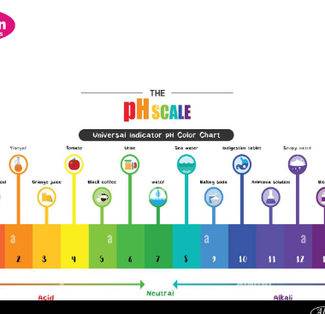



Question 09 / 20
Which of the following compounds is used as an antacid to relieve stomach acidity?
Sodium carbonate (Na₂CO₃)
Sodium hydrogen carbonate (NaHCO₃)
Calcium chloride (CaCl₂)
Sodium hydroxide (NaOH)
Class 10 Science • Chemistry
Slide 20

Slide 21
Answer & Explanation • Q09
Sodium hydrogen carbonate (Baking Soda, NaHCO₃)
Detailed Explanation
Antacids neutralise excess stomach hydrochloric acid (HCl):
•
NaHCO₃ is a mild, non-corrosive basic salt that safely neutralises excess stomach acid.
•
NaOH is a strong, highly corrosive base (unsuitable for consumption).
•
Na₂CO₃ is strongly alkaline and can irritate the digestive tract.
Class 10 Science • Chemistry
Slide 21

Slide 22

Question 10 / 20
What is the chemical formula of Plaster of Paris?
CaSO₄ · 2H₂O
CaSO₄ · ½H₂O
CaSO₄ · 10H₂O
CaCO₃ · ½H₂O
Class 10 Science • Chemistry
Slide 22

Slide 23
Answer & Explanation • Q10
CaSO₄ · ½H₂O (Calcium Sulphate Hemihydrate)
Detailed Explanation
Plaster of Paris is formed by heating Gypsum at 373 K (100°C):
•
Two formula units of CaSO₄ share one molecule of water of crystallisation.
•
Mixing Plaster of Paris with water converts it back to hard Gypsum (CaSO₄·2H₂O).
Class 10 Science • Chemistry
Slide 23

Slide 24
Question 11 / 20
When carbon dioxide gas is passed through lime water for a short duration, lime water turns milky due to the formation of:
Calcium hydrogen carbonate
Calcium oxide
Calcium carbonate
Calcium sulphate
Class 10 Science • Chemistry
Slide 24

Slide 25
Answer & Explanation • Q11
Calcium carbonate (CaCO₃)
Detailed Explanation
•
Insoluble Calcium Carbonate (CaCO₃) gives the solution a characteristic milky white appearance.
•
Note: Passing excess CO₂ dissolves the precipitate by forming soluble Calcium Hydrogen Carbonate [Ca(HCO₃)₂].
Class 10 Science • Chemistry
Slide 25

Slide 26
Question 12 / 20
Nettle sting causes a sharp burning pain due to the injection of which acid?
Methanoic acid (Formic acid)
Ethanoic acid (Acetic acid)
Tartaric acid
Oxalic acid
Class 10 Science • Chemistry
Slide 26

Slide 27

Answer & Explanation • Q12
Methanoic acid (HCOOH)
Detailed Explanation
Natural sources of organic acids and remedies:
•
Nettle plant sting hair injects Methanoic acid into the skin, causing severe burning pain.
•
Rubbing the leaves of the dock plant (which grows near nettle plants) neutralises the acid because dock leaves contain a mild base.
Class 10 Science • Chemistry
Slide 27

Slide 28
Question 13 / 20
Which salt has 10 molecules of water of crystallisation?
Baking soda
Washing soda
Bleaching powder
Blue vitriol
Class 10 Science • Chemistry
Slide 28

Slide 29
Answer & Explanation • Q13
Washing soda (Na₂CO₃ · 10H₂O)
Detailed Explanation
Recrystallisation of sodium carbonate gives washing soda:
•
Washing Soda: Na₂CO₃ · 10H₂O (10 water molecules).
•
Blue Vitriol: CuSO₄ · 5H₂O (5 water molecules).
•
Baking Soda: NaHCO₃ (No water of crystallisation).
Class 10 Science • Chemistry
Slide 29

Slide 30
Question 14 / 20
Tooth decay starts when the pH of the mouth drops below:
pH 5.5
pH 6.5
pH 7.5
pH 8.5
Class 10 Science • Chemistry
Slide 30

Slide 31
Answer & Explanation • Q14
pH 5.5
Detailed Explanation
Tooth enamel is made of Calcium hydroxyapatite (crystalline calcium phosphate), the hardest substance in the human body:
•
Bacteria in the mouth degrade food/sugar particles, producing acids.
•
When mouth pH falls below 5.5, enamel begins to corrode.
•
Using alkaline toothpaste neutralises the acid and prevents decay.
Class 10 Science • Chemistry
Slide 31

Slide 32

Chapter 3: Metals and Non-Metals
Questions 15 to 20 • Focus on Metallurgy, Reactivity & Amphoteric Oxides

Slide 33
Question 15 / 20
Which of the following oxides shows amphoteric behaviour (reacts with both acids and bases)?
Na₂O
MgO
Al₂O₃
CaO
Class 10 Science • Chemistry
Slide 33

Slide 34

Answer & Explanation • Q15
Al₂O₃ (Aluminium Oxide)
Detailed Explanation
Amphoteric oxides react with both acids and bases to produce salt and water:
Zinc oxide (ZnO) is another prominent example of an amphoteric oxide.
Class 10 Science • Chemistry
Slide 34

Slide 35
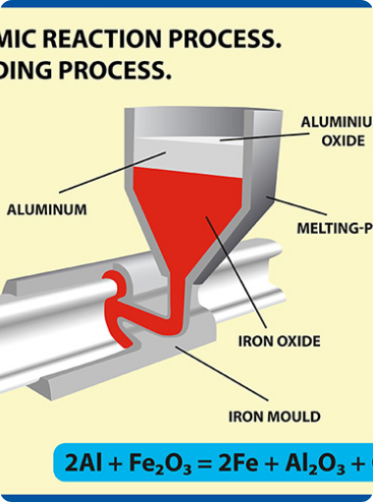
Question 16 / 20
The reduction reaction used to join railway tracks utilizing molten iron is called the:
Roasting process
Calcination process
Thermite process
Electrolytic refining
Class 10 Science • Chemistry
Slide 35

Slide 36
Answer & Explanation • Q16
Thermite process
Detailed Explanation
•
The displacement reaction of Iron(III) oxide with Aluminium powder is highly exothermic.
•
The heat released is so huge that iron is produced in a molten state, which is used to weld railway tracks or cracked machine parts.
Class 10 Science • Chemistry
Slide 36

Slide 37
Question 17 / 20
Which non-metal is a good conductor of electricity?
Diamond
Iodine
Graphite
Sulphur
Class 10 Science • Chemistry
Slide 37

Slide 38
Answer & Explanation • Q17
Graphite (Allotrope of Carbon)
Detailed Explanation
Non-metals are generally electrical insulators, but graphite is an exception:
•
In graphite, each carbon atom is bonded to 3 other carbon atoms in hexagonal layers.
•
This leaves one delocalised free electron per carbon atom that can move freely and carry electrical current.
Class 10 Science • Chemistry
Slide 38

Slide 39
Question 18 / 20
During electrolytic refining of copper, pure copper gets deposited at the:
Anode
Cathode
Bottom of tank (Anode mud)
Electrolyte solution only
Class 10 Science • Chemistry
Slide 39

Slide 40

Answer & Explanation • Q18
Cathode (Negative Electrode)
Detailed Explanation
In electrolytic refining of copper:
•
Anode (+): Impure copper block.
•
Cathode (-): Thin strip of pure copper.
•
Reaction at Cathode: Cu²⁺ ions accept electrons and deposit as pure copper:
Class 10 Science • Chemistry
Slide 40

Slide 41
Question 19 / 20
Cinnabar is a major ore of which metal?
Copper
Zinc
Mercury
Lead
Class 10 Science • Chemistry
Slide 41

Slide 42

Answer & Explanation • Q19
Mercury (Hg)
Detailed Explanation
Cinnabar is Mercuric Sulphide (HgS), a sulfide ore of low reactivity metal:
Simply heating Cinnabar in air converts it first into mercuric oxide, which on further heating reduces to liquid mercury metal.
Class 10 Science • Chemistry
Slide 42

Slide 43
Question 20 / 20
Bronze is a homogenous alloy composed of which two constituent metals?
Copper and Zinc
Copper and Tin
Lead and Tin
Iron and Carbon
Class 10 Science • Chemistry
Slide 43

Slide 44
Answer & Explanation • Q20
Copper and Tin (Cu + Sn)
Detailed Explanation
Key Class 10 Alloys to remember:
•
Bronze: Alloy of Copper (Cu) and Tin (Sn).
•
Brass: Alloy of Copper (Cu) and Zinc (Zn).
•
Solder: Alloy of Lead (Pb) and Tin (Sn) [low melting point used for welding electrical wires].
Class 10 Science • Chemistry
Slide 44

